Slide 1
How to Report
PreSchool Students
Presented by:
Anju Mansharamani Michele Hausmann

Slide 2
Acronyms
PD Data System
CPSE
CSE
PS
SEDCAR
VR

Slide 3
Acronyms
CPSE: Committee on Preschool Special Education. Determines services for preschool-aged students with a disability (grade PS and PK).
CSE: Committee on Special Education. Oversees services for school-aged students with a disability (Grades K-12, 13, & 14).
PD Data System: Pupils with Disability Data System.
PS: Preschool grade ordinal.
SEDCAR: Special Education Data Collection, Analysis and Reporting.
VR: Verification Report.

Slide 4
Agenda
Definition of a PreSchool Student
Overview
Enrollment Scenarios
Transitions
End of Year Reporting
Where does this data show up?
Potential Errors
References and Tips

Slide 5
Definition of a PreSchool Student
Preschool-aged Student:
Any child age 3-5 who is not enrolled in Kindergarten. Students in grade PS or PK are considered pre-school age.
PS Grade Ordinal:
The PS (Preschool) grade ordinal is used for a child in CPSE determination or a child who is receiving preschool special-education services and is not in a Pre-K program.

Slide 6
An Overview of the Determination Phase
Referral
Consent
Evaluation
Determination
The Referral Process
Children are referred to the school district’s CPSE if they are suspected of having a disability which impairs their learning and development.
Consent
The parent sends written consent. If the parent does not give consent for the initial evaluation, the parent is notified that no further action takes place.
Evaluation
The evaluation of a PS child requires information gathering and the process includes the sharing of results among evaluators and the CPSE.
Notes:
References:
http://www.p12.nysed.gov/specialed/publications/policy/evalsappd.htm
http://www.p12.nysed.gov/specialed/publications/policy/individevalcontents.htm

Slide 7
Enrollment Scenarios

Slide 8
Determination Phase
The Determination Phase is only applicable to preschool-aged students not already enrolled at your district. Do not report the Determination Phase if the student is already enrolled in Pre-K.
Enrollment
Entry Code : 4034 - “Preschool-age students enrolled solely for determining eligibility for special education services.”
Enrollment Location: ALWAYS at the District (0000).
Grade: PS
Exit Code : 140 - “Special education eligibility status determined or determination process stopped for any reason.”
Program Services
None

Only school districts that are required to report data on the timely evaluation of preschool and school-age children for special-education eligibility or on the timely transition of children from Early Intervention to preschool (SPP Indicators 11 and 12) are required to report this type of an enrollment record.

Per the Table of Reporting Responsibility for Pre-School-Age and Prekindergarten Students
Notes:
NERIC recommends this data be reported annually for consistent practice and tracking purposes.

Slide 9
Determined Eligible and Receiving Services
If a PS student is determined eligible for Special Education Services:
Enrollment
Entry Code : 0011 - “Enrollment in building or grade.”
Enrollment Location – The agency providing the special education service.
Refer to the Table of Reporting Responsibility for Preschool-Age and Prekindergarten Students in SIRS Manual.
Grade - PS
If student is declassified or has been withdrawn from school by a parent/guardian report the 425: Left school, no documentation of transfer exit code.
Program Services
Disability Code – 5786: “Preschool Student with a Disability.” Start date must be on or subsequent to the beginning date of the 0011 enrollment.
If the student is declassified (or parent revokes consent) for special-education services, report the 901: “Declassified” ending reason code.

Slide 10
Determined Ineligible
If a PS student is determined ineligible for Special Education Services:
Enrollment
Entry Code - 4034: “Preschool-age students enrolled solely for determining eligibility for special education services.”
Enrollment Location: ALWAYS at the District (0000).
Grade: PS
Exit Code - 140: “Special education eligibility status determined or determination process stopped for any reason.”
Program Services
None.

Slide 11
Parental Consent before or after June 30th
If Parental Consent to Evaluate is received on or before June 30, 20xx: Enrollment Exit Code – 140: “Special education eligibility status determined or determination process stopped for any reason.”
Grade - PS
If student is declassified or has been withdrawn from school by a parent/guardian report the 425: Left school, no documentation of transfer exit code.
Program Services
Disability Code – 5786: “Preschool Student with a Disability.” Start date must be on or subsequent to the beginning date of 0011 enrollment.
If student is declassified or parent revoke consent for special-education services, report the 901: “Declassified” ending reason code.
If Parental Consent to Evaluate is received on or before June 30, 20xx.
Enrollment: Exit Code - 140: “Special education eligibility status determined or determination process stopped for any reason.”
Exit Date - 06/30/20XX.
If the student is determined eligible in the subsequent year:
Enrollment: Entry Code - 0011: “Enrollment in building or grade.”
Enrollment Location: Where the special education services are provided.
Grade: PS
Entry Date: The day they start getting services.
Program Services
Disability Code: 5786: “Preschool Student with a Disability.” The start date must on or after date of 0011 enrollment.
Do not report the determination enrollment in the next year.
If, in next reporting year the student is Determined NOT eligible: Report no further Enrollment or Program Service records.

Slide 12
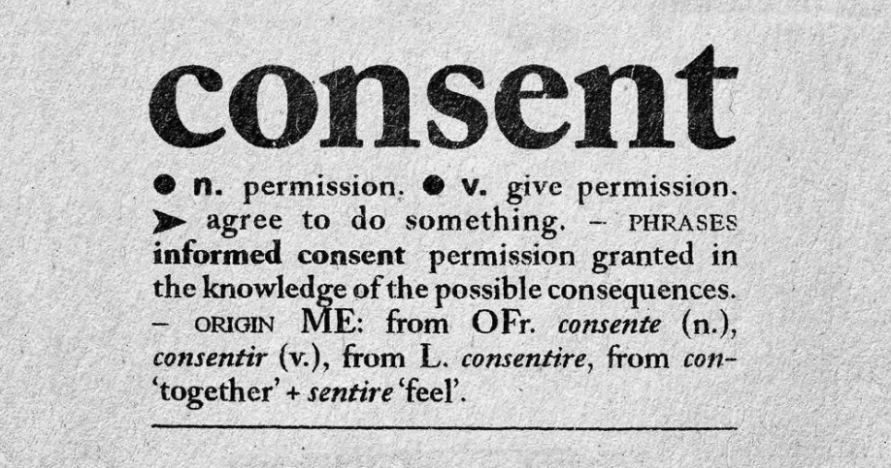
Parental Consent before or after June 30th
If Parental Consent to Evaluate is NOT received prior to June 30th
In next reporting year
Enrollment
Entry Code: 4034- “Preschool-age students enrolled solely for determining eligibility for special education services”
Enrollment Location: District (0000).
Grade: PS
Entry Date: Date Parent consent has been received.
Notes:
Begin their enrollment when consent is received. If you report the 4034 when the student is referred, but consent is received in the subsequent school year, report the 4034/140 again in the following school year. The 4034 has to be reported in the year that the consent is received in order to report the events. Events begin in the year you receive consent.

Slide 13
PS CPSE student moves into your district
When a grade PS CPSE student moves into your district:
Enrollment
Entry Code: 0011- “Enrollment in building or grade”
Enrollment Location: The agency providing the special education services.
Refer to the “Table of Reporting Responsibility for Preschool-Age and Prekindergarten Students” in the SIRS Manual.
Grade: PS
If student is declassified or has been withdrawn from school by a parent/guardian use Exit Code 425: Left school, no documentation of transfer.
Program Services
Disability Code: 5786- “Preschool Student with a Disability”. Start date must on or later than date of 0011 enrollment.
If student is declassified or parent revoke consent for special-education services, use code 901: “Declassified”.

Slide 14
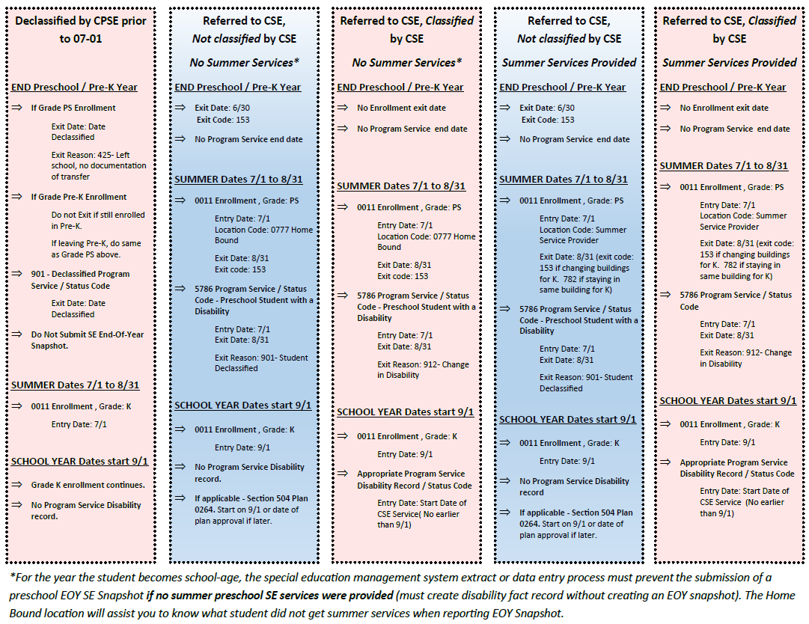
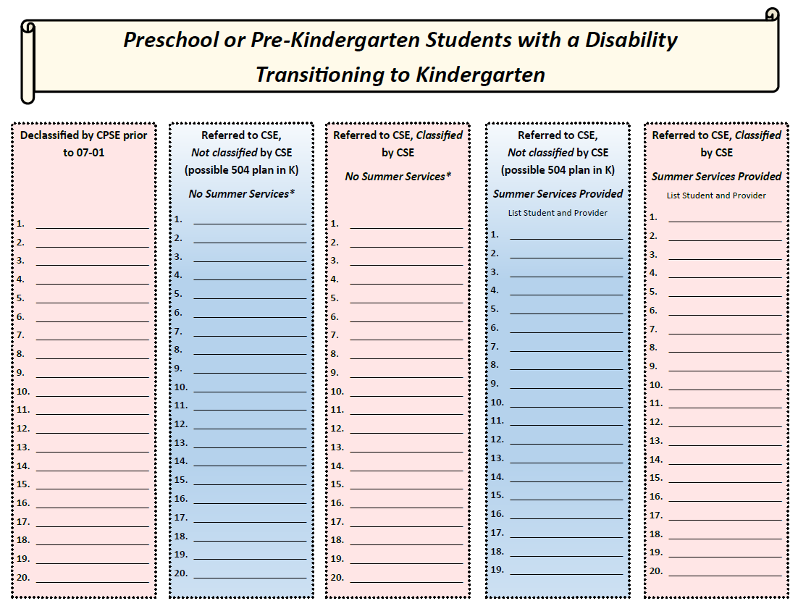

Slide 15
Transitions

Slide 16
PS Student Going from CPSE to CPSE
A grade PS student who is continuing in PS next year:
Enrollment
Entry Code: 0011- “Enrollment in building or grade”
Entry Date: 07/01/XX
Enrollment Location: The agency providing the special education service.
Refer to “Table of Reporting Responsibility for Preschool-Age and Prekindergarten Students.”
Grade: PS
If student is declassified or has been withdrawn from school by a parent/guardian use Exit Code 425: Left school, no documentation of transfer.
Program Services
Disability Code: 5786- “Preschool Student with a Disability”.
Start Date: 07/01/20XX.

Slide 17
PS to PK
A grade PS CPSE student who transitions to Pre-K over the summer:
Summer PS Enrollment
Entry Code: 0011- “Enrollment in building or grade.”
Entry Date: 07/01/20XX.
Enrollment Location: The agency providing the special education service.
Grade: PS
Exit Code: 153- “Transferred to another school in this district” (unless they are staying in same location for Pre-K as PS, then use 782 - “Entry into a different grade in the same school building”).
Exit Date: 8/31/20XX
Subsequent Enrollment: Grade PK on 9/1/20XX with a 0011 beginning enrollment code.
Program Services
Disability Code: 5786- “Preschool Student with a Disability”.
Start on 07/01/20XX and keep open unless declassified

Slide 18
PS to K
A grade PS CPSE student who transitions to K over the summer:
Summer PS Enrollment
Entry Code: 0011- “Enrollment in building or grade”
Entry Date: 07/01/20XX
Enrollment Location: The agency providing the special education service. If no service is provided over the summer, NERIC’s recommended practice is to enroll the student in the 0777 “Homebound” location.
Grade: PS
Exit Code: 153- “Transferred to another school in this district” (unless they are staying in same location for Kindergarten as PS, then use 782 - “Entry into a different grade in the same school building”)
Exit Date: 8/31/20XX
Program Services
Disability Code: 5786- “Preschool Student with a Disability”.
Start on 07/01/20XX and end on 8/31/20XX.
The 5786 Program Fact record aligns with the PS enrollment; a School-Aged Disability record is reported within the grade K-14 enrollment, as applicable.
Notes:
SED requires that the PS students are enrolled for the summer as a PS student because they are not considered a Kindergarten student until 9/1. In the case of a PS student who transitions from PS to K, a PS summer enrollment must be report from 7/1-8/31. NERIC’s recommended practice is to report the student’s who are not receiving summer services in the Homebound location (0777 location) to delineate the student’s who received summer services, which will be helpful to your business officials as well as helping to identify which students should have an SE EOY Snapshot record.
Special Education systems are designed to export with the end date of 8/31.

Slide 19
End of Year Reporting

Slide 20
BEDS Day Snapshot
BEDS Day Snapshot records reflect students who receive Special Education Services as of BEDS Day.
BEDS Day is the first Wednesday in October.

Slide 21
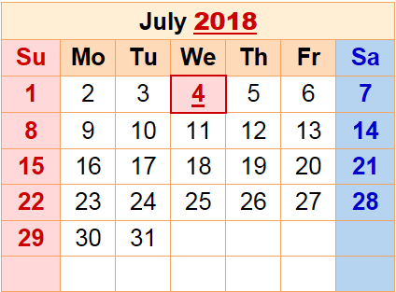
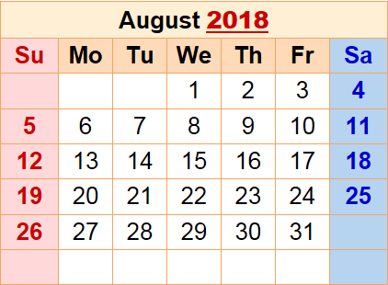
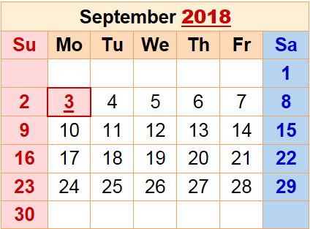
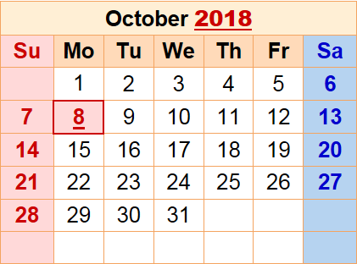
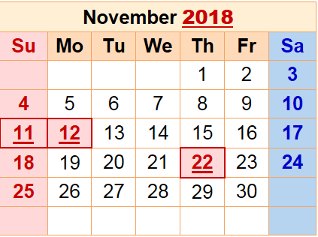
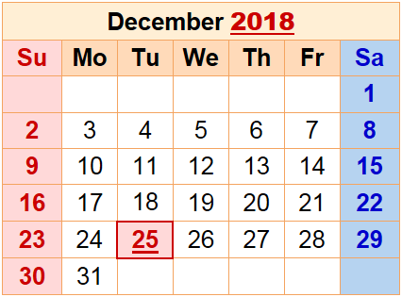
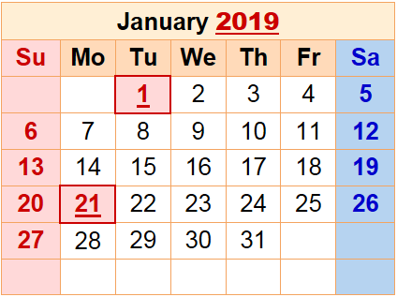
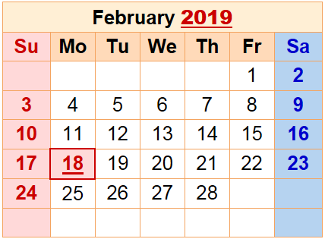
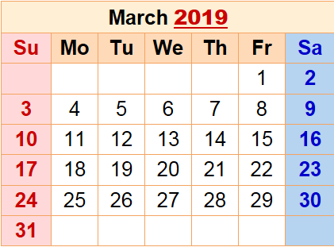
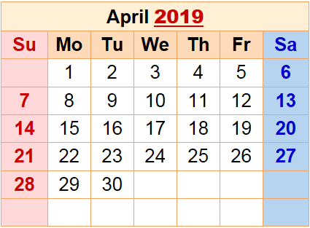
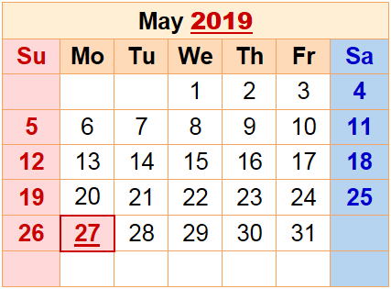
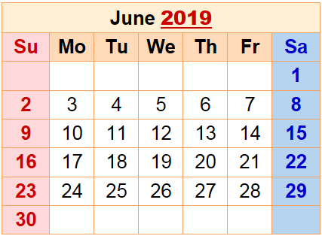
End of Year Reporting
Students who receive CPSE services at any time during the school year are reported with an End of Year Snapshot record indicating their Primary Service Code and Primary Service Provider.
S.E. Events can be reported beyond the End of Year reporting deadline as long as the student’s Demographic and Enrollment record is reported prior to the End of Year data freeze.
The Special Education and Registration offices in your district/school need to understand the CPSE to CSE transition process and everyone's roles in reporting.
Make sure the details of all students transitioning to CSE are understood and shared appropriately.
Notes:
The End of Year Snapshot has a beginning of the school year date and is reported for any student who has a Type of Disability program fact record reported at any point during the school year.

Slide 22
Potential Errors

Slide 23
Potential Errors
EE2027: A state entry code of 4034 or exit code of 140 requires a PRES grade ordinal.

Slide 24
Potential Errors
EE2030: 4034 state entry code and 140 state exit code can only be paired with one another.
.
Enrollment Code 4034
Grade must be PS
Location must be the ‘District’ Level
Corresponding Exit Code must be 140
Program Service Code 5786
Must be used with Grade PS
Program Service dates for the ‘Type of Disability’ record should align with the corresponding Enrollment Dates
If ended with exit code 912; must have a new disability reported.
County (as the Service Provider) Location codes can only be used with grade PS
All End-of-Year Snapshot records must have an active Enrollment record, other than 4034, at some time during the school year.

Slide 25
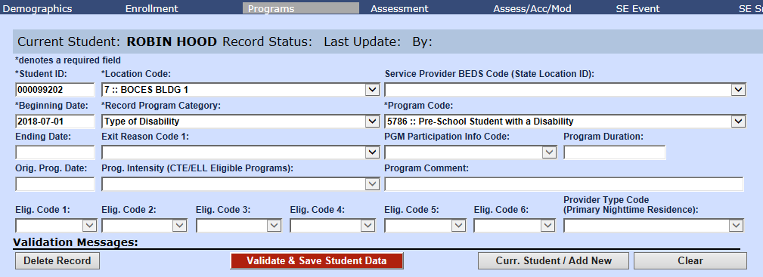
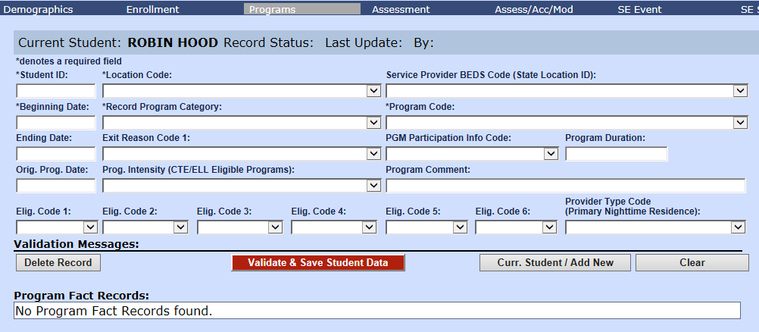
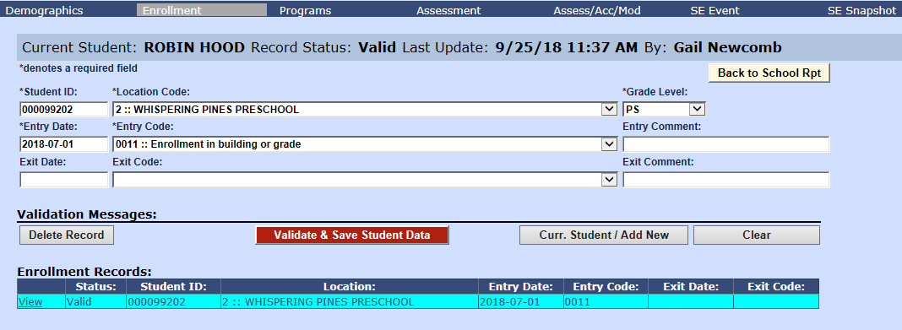
Potential Errors
EE2068: 0011/5905 PRES enrollment does not have an associated 5786 Preschool Type of Disability.
District-Level Service
Enrollment Code 4034
Grade must be PS
Location must be the ‘District’ Level
Corresponding Exit Code must be 140
Program Service Code 5786
Must be used with Grade PS
Program Service dates for the ‘Type of Disability’ record should align with the corresponding Enrollment Dates
If ended with exit code 912; must have a new disability reported.
County (as the Service Provider) Location codes can only be used with grade PS
All End-of-Year Snapshot records must have an active Enrollment record, other than 4034, at some time during the school year.
5905: CSE or CPSE responsibility only

Slide 26
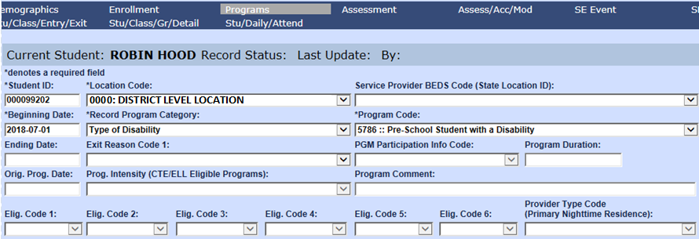
Potential Errors
PS3091: A Preschool student w/disability record (5786) can only have an associated 0011/5905 enrollment grade ordinal of PREKF, PREKH, or PRES during the same time period.
Grade Level can only be reported as PS, PKF, or PKH.

Slide 27
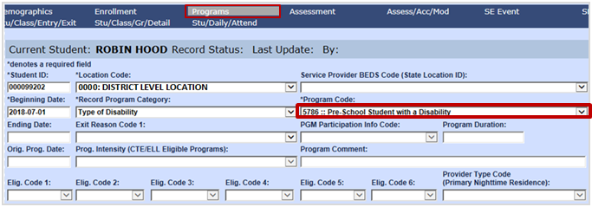
Potential Errors
SS4015: EOY snapshots require a 5786 disability record at some point during the school year.
An SE EOY Snapshot Record requires a 5786 program record.

Slide 28
Where does this data show up?

Slide 29
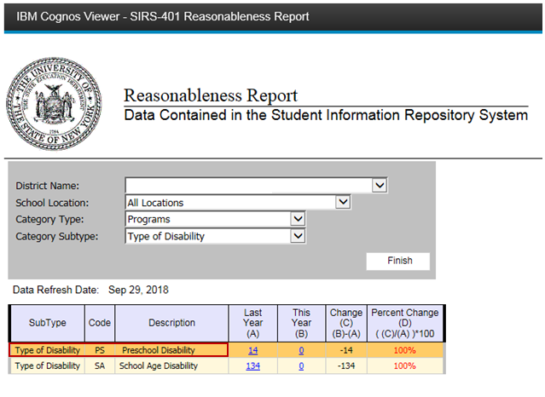
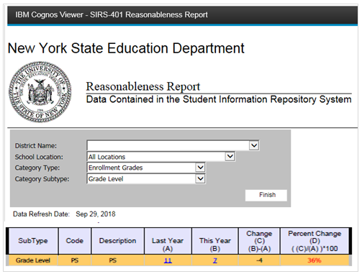
Cognos Level 2 Report
SIRS-401 Reasonableness Report

Slide 30
PD Data System
VR 1: Preschool Child Count Report by Race/Ethnicity
VR 4: Preschool LRE Setting Report
VR 6: District Report of Preschool Students by Primary Service Provider
VR 7: Provider Report of Preschool Students
VR11: Percent of children (preschool and school age) with parental consent to evaluate, who were evaluated within State established timelines. (Indicator 11)
VR-12: Percent of Children Referred by Part C Prior to Age 3, who are Found Eligible for Part B, and who Have an IEP Developed and Implemented by Their Third Birthday (Indicator 12)
VR 13: Preschool Children Provided Programs and Services during School Year
VR 15: Preschool Outcomes Report (Indicator 7)
October Reports:
VR 1: Preschool Child Count Report by Race/Ethnicity.
VR 4: Preschool LRE Setting Report.
VR 6: District Report of Preschool Students by Primary Service Provider.
VR 7: Provider Report of Preschool Students. All school districts are responsible for the certification of these reports.
End of Year Reports:
VR 11: Percent of children (preschool and school age) with parental consent to evaluate, who were evaluated within State established timelines. (Indicator 11).
VR 12: Percent of Children Referred by Part C Prior to Age 3, who are Found Eligible for Part B, and who Have an IEP Developed and Implemented by Their Third Birthday (Indicator 12).
VR 13: Preschool Children Provided Programs and Services during School Year.
VR 15: Preschool Outcomes Report (Indicator 7).
VR 13 – All districts.
11, 12, and 15 are based on the Federal Indicators, as per the Submission Schedule.
PD Data System
2018-19 Due Dates
Granting PD Entitlements
PD System FAQs

Slide 31
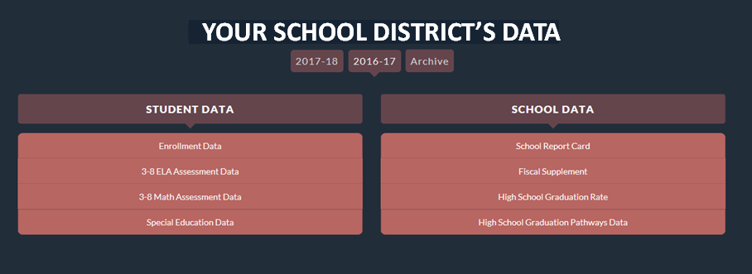
NYS Report Card
Indicator 7: Preschool Outcomes - Data verified in VR15
Indicator 11: Timely Evaluations
Indicator 12: Early Childhood Transition
data.nysed.gov

Slide 32
References and Tips

Slide 33
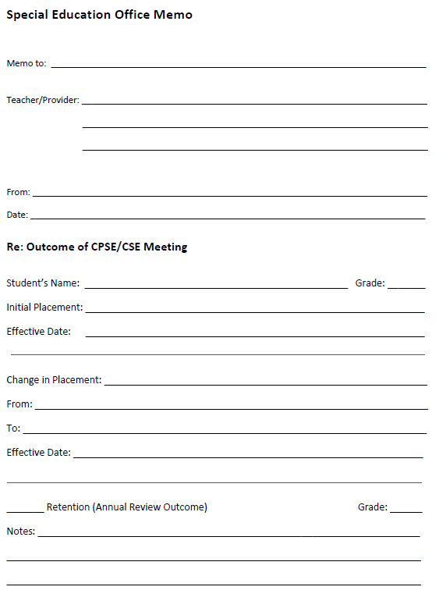
References and Tips
Communication is KEY!
It is important for your LEA’s CPSE staff and registration office to understand the entire reporting cycle for these students and to understand when communication is necessary.

Slide 34
References and Tips
SIRS Manual
SEDREF
SEDCAR
New York State Report Card
NYSED’s How to Grant PD Entitlements
PD Data System Resources
Special Education Office Form

